Slide 1
Youth Housing First

Slide 2
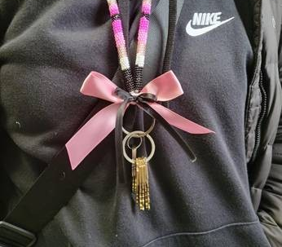
Youth Housing First Program Overview
The Youth Housing First program (YHF) follows the Critical Time Intervention (CTI) model.
This program was created to help youth, aged 16-24, find sustainable housing in accordance with the principles of CTI & Rapid Re-Housing.
The target youth population are episodic homeless youth who are experiencing unhealthy living situations beginning to negatively impact major life areas. Major life areas are defined as family, spiritual, employment/education, peers, intimate relationships, financial, and physical/mental health.
Notes:
CTI stands for Critical Time Intervention. It is a time-limited evidence-based practice that mobilizes support for society’s most vulnerable individuals during periods of transition. It facilitates community integration and continuity of care by ensuring that a person has enduring ties to their community and support systems during these critical periods. CTI has been applied with veterans, people with mental illness, people who have been homeless or in prison, and many other groups. The model has been widely used on four continent

Slide 3
The objectives of the Youth Housing First Program are to:
Reduce length of time youth experience homelessness
Increase the rate which youth are placed in safe, secure, and sustainable permanent housing.
Provide support during the critical time of transition.
*All Referrals are done with Coordinated Access through Homeward Trust Edmonton.
This puts the youth on the By Names List and looked at by all Housing First Teams*

Slide 4

Critical Time Intervention (CTI) is a phased approached to help support youth in that critical time of transition. The three phases allow staff to offer more intensive support at the start of the program and gradually reduce hands on support as their independence grows.
Pre- CTI – Intake
Phase 1 – Transition Phase
Phase 2 – Try-Out Phase
Phase 3 – Transfer of Care
Notes:
Pre CTI-Develop a trusting relationship with client.
Phase One-
Provide support & begin to connect client to people and agencies that will assume the primary role of support.
Make home visits
Engage in collaborative assessments
Meet with existing supports
Introduce client to new supports
Give support and advice to client and caregivers
Phase 2: Try-Out
Monitor and strengthen support network and client’s skills.
Observe operation of support network
Mediate conflicts between client and caregivers
Help modify network as necessary
Encourage client to take more responsibility
Phase 3: Transfer of Care
Terminate CTI services with support network safely in place.
Step back to ensure that supports can function independently
Develop and begin to set in motion plan for long-term goals
Hold meeting with client and supports to mark final transfer of care
Meet with client for last time to review progress made

Slide 5

In the last three months youth housing first has successfully housed 9 youth.
Before receiving support with YHF
these youth were staying in shelters and unsafe home situations.

Slide 6

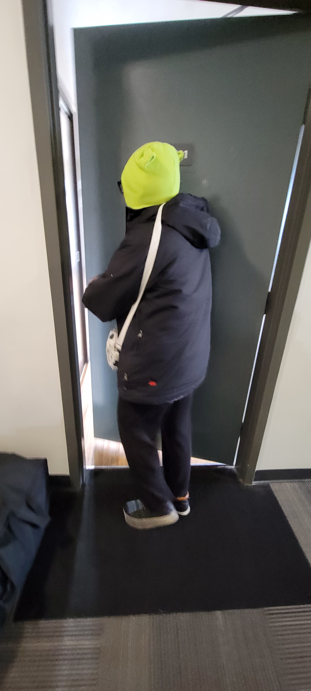
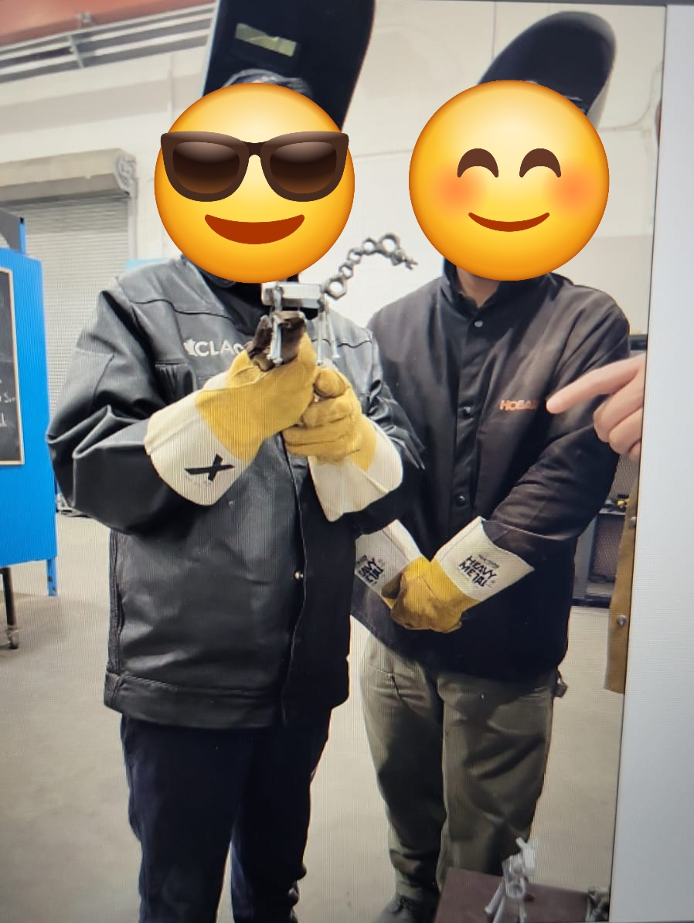

Why Is Housing Important?
Sense of safety
Focus on employment and education
Raise a family in a healthy environment
Able to maintain mental health
Focus on hobbies
Celebrations of culture, religion, milestones,
“We know well from evidence that if we let young people become and remain homeless for any length of time, the risk of exploitation and criminal victimization, coupled with the rigors of life on the streets, can result in compromised health, declining mental health, increased substance use, and becoming entrenched on the streets”-Homelesshub.ca

Slide 7
Empowering Youth for Housing Success: Practical Skills, Support, and Connection
Mock Apartment Viewing – Giving participants real life scenarios to prepare them for meeting landlords
Rental Application Prep Class – Helping participants complete mock rental applications with constructive feedback
Landlord Handbook – Explaining the YHF support workers role, how YHF can support the landlord, includes phone numbers to call for after hours support
YHF Alumni Group – BBQ’s and get-togethers for youth who have completed, or are currently enrolled, to feel connected to community.
Notes:
Discuss the why behind these decisions and steps you are taking

Slide 8


